Slide 1
End-to-end Recovery of
Human Shape and Pose
Angjoo Kanazawa , Michael J. Black, David W. Jacobs, and Jitendra Malik
arXiv:1712.06584v1 [cs.CV] 18 Dec 2017
2018-06-13
Yucheng Lu

Slide 2
Contents
Introduction
Related works
Proposed method
Experiment result

Slide 3
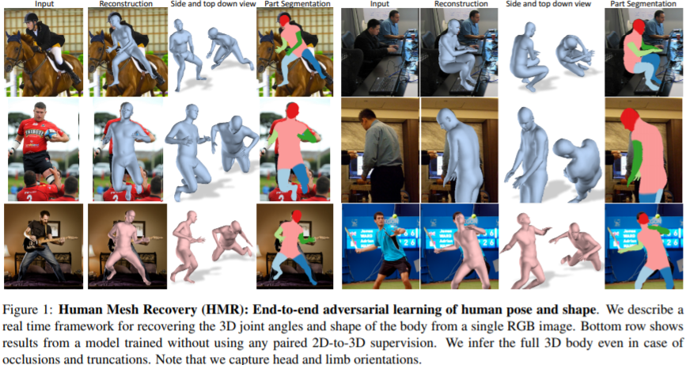
Introduction
This paper proposed an end-to-end framework for reconstructing a full 3D mesh of a human from a single RGB image, called Human Mesh Recovery (HMR).
The proposed method doesn’t rely on intermediate 2D keypoint detection or any paired 2D-to-3D supervision.

Slide 4
Related works
Two stage method:
First predict 2D joint locations by 2D pose detector or ground truth 2D pose, then predict 3D joint locations from the 2D joints by regression or model fitting.
Robust to domain shift, but rely too much on 2D joint detections, and may throw away image information in estimating 3D pose.
Direct estimation:
Learn 3D joints directly from images in a deep learning framework by estimating the depth relative to root and using a pre-defined global scale based on the average of bones.
Trained on controlled environment, do not generalize well to the real world.

Slide 5
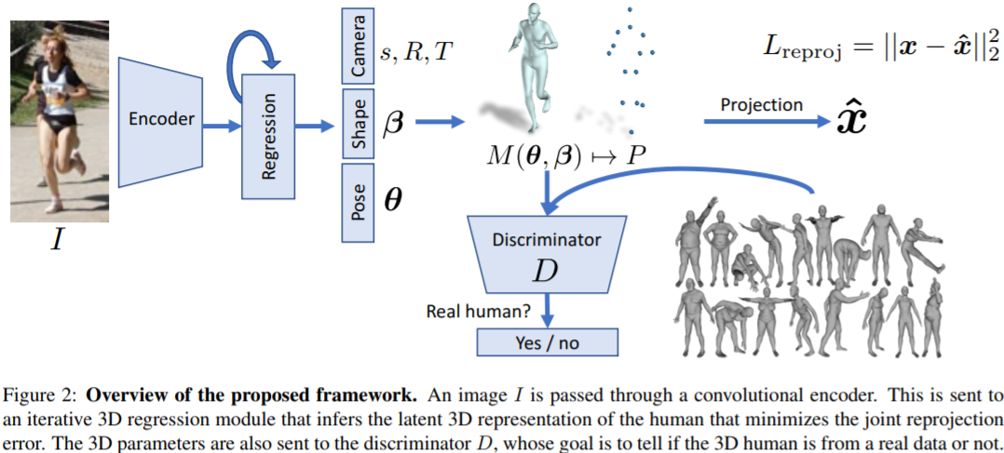
Proposed method

Slide 6
Proposed method
Encoder: extract features from input image;
3D regressor: infer the 3D human body and the camera such that its 3D joints project onto the annotated 2D joints;
Discriminator: determine if the 3D parameters are real meshes from the unpaired dataset or not.
Overall loss function:
Regressor loss
3D ground truth loss
Discriminator loss

Slide 7
Proposed method
3D body representation (SMPL):
SMPL factorizes the human body into shape (first 10 values of a PCA shape space), pose (relative 3D rotation of K=23 joints in axis-angle representation), and camera pose. The total number of parameters in SMPL is：
SMPL is a differentiable function that outputs a triangulated mesh with N=6980 vertices, for simplify we only use P keypoints:

Slide 8
Proposed method
Iterative 3D regressor with feedback:
The goal is to take and encoded image and output such that the joint re-projection error is minimized:
The 3D regressor takes the image features and the previous output parameters as input, and computes the residual, the new parameters are updated by:

Slide 9
Proposed method
Additional 3D supervision:
When paired ground truth 3D data is available, 3D losses can be used to further improve the performance:

Slide 10
Proposed method
Factorized adversarial prior:
Bodies with gross self-intersections may still minimize the re-projection loss. To regularize this, we use a discriminator to tell whether a SMPL parameters is from a real scan or not.

Slide 11
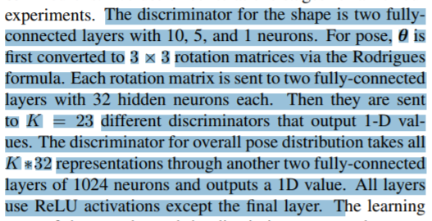
Experiment result
Implementation details:
In-th-wild image datasets: LSP, LSP-extended, MPII and MS COCO.
3D datasets: Human3.6M and MPIINF-3DHP.
Datasets for discriminator: CMU, Human3.6M and the PosePrior.
Encoder: ResNet-50
3D regreesor: two FCs (1024 neurons each with dropout in between) + one output FC (85 neurons).
Discriminator:

Slide 12
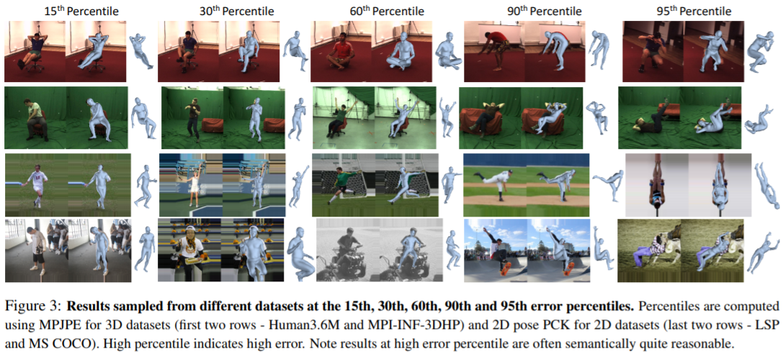
Experiment result

Slide 13
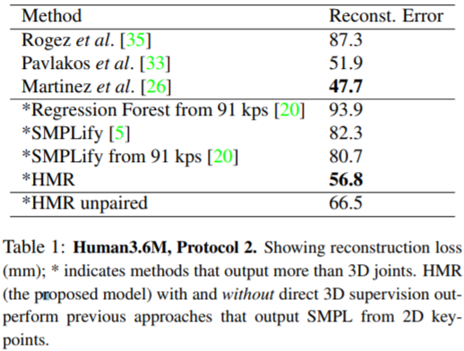
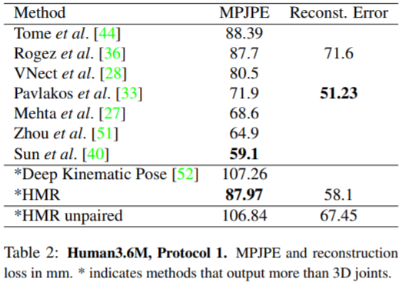
Experiment result

